Slide 1
Introduction to Evolutionary Computation
Evolutionary Computation is the field of study devoted to the design, development, and analysis is problem solvers based on natural selection (simulated evolution).
Evolution has proven to be a powerful search process.
Evolutionary Computation has been successfully applied to a wide range of problems including:
  Aircraft Design,
  Routing in Communications Networks,
  Tracking Windshear,
  Game Playing (Checkers [Fogel])

Slide 2
Introduction to Evolutionary Computation
(Applications cont.)
Robotics,
Air Traffic Control,
Design,
Scheduling,
Machine Learning,
Pattern Recognition,
Job Shop Scheduling,
VLSI Circuit Layout,
Strike Force Allocation,

Slide 3
Introduction to Evolutionary Computation
(Applications cont.)
Theme Park Tours (Disney Land/World) http://www.TouringPlans.com
Market Forecasting,
Egg Price Forecasting,
Design of Filters and Barriers,
Data-Mining,
User-Mining,
Resource Allocation,
Path Planning,
Etc.

Slide 4
Introduction to Evolutionary Computation
(cont.)
An Example Evolutionary Computation
Procedure EC{
t = 0;
Initialize Pop(t);
Evaluate Pop(t);
While (Not Done)
{
Parents(t) = Select_Parents(Pop(t));
Offspring(t) = Procreate(Parents(t));
Evaluate(Offspring(t));
Pop(t+1)= Replace(Pop(t),Offspring(t));
t = t + 1;
}

Slide 5
Introduction to Evolutionary Computation
(cont.)
In an Evolutionary Computation, a population of candidate solutions (CSs) is randomly generated.
Each of the CSs is evaluated and assigned a fitness based on a user specified evaluation function. The evaluation function is used to determine the ‘goodness’ of a CS.
A number of individuals are then selected to be parents based on their fitness. The Select_Parents method must be one that balances the urge for selecting the best performing CSs with the need for population diversity.

Slide 6
Introduction to Evolutionary Computation
(cont.)
The selected parents are then allowed to create a set of offspring which are evaluated and assigned a fitness using the same evaluation function defined by the user.
Finally, a decision must be made as to which individuals of the current population and the offspring population should be allowed to survive. Typically, in EC , this is done to guarantee that the population size remains constant. [The study of ECs with dynamic population sizes would make an interesting project for this course]

Slide 7
Introduction to Evolutionary Computation
(cont.)
Once a decision is made the survivors comprise the next generation (Pop(t+1)).
This process of selecting parents based on their fitness, allowing them to create offspring, and replacing weaker members of the population is repeated for a user specified number of cycles.
Stopping conditions for evolutionary search could be:
  The discovery of an optimal or near optimal solution
  Convergence on a single solution or set of similar solutions,
  When the EC detects the problem has no feasible solution,
  After a user-specified threshold has been reached, or
  After a maximum number of cycles.

Slide 8
A Brief History of Evolutionary Computation
The idea of using simulated evolution to solve engineering and design problems have been around since the 1950’s (Fogel, 2000).
  Bremermann, 1962
  Box, 1957
  Friedberg, 1958
However, it wasn’t until the early 1960’s that we began to see three influential forms of EC emerge (Back et al, 1997):
  Evolutionary Programming (Lawrence Fogel, 1962),
  Genetic Algorithms (Holland, 1962)
  Evolution Strategies (Rechenberg, 1965 & Schwefel, 1968),

Slide 9
A Brief History of Evolutionary Computation:
The Evolution of Evolutionary Computation
First Generation EC
  EP (Fogel)
  GA (Holland)
  ES (Rechenberg, Schwefel)
Second Generation EC
  Genetic Evolution of Data Structures (Michalewicz)
  Genetic Evolution of Programs (Koza)
  Hybrid Genetic Search (Davis)
  Tabu Search (Glover)

Slide 10
A Brief History of Evolutionary Computation:
The Evolution of Evolutionary Computation (cont.)
Third Generation EC
  Artificial Immune Systems (Forrest)
  Cultural Algorithms (Reynolds)
  DNA Computing (Adleman)
  Ant Colony Optimization (Dorigo)
  Particle Swarm Optimization (Kennedy & Eberhart)
  Memetic Algorithms
  Estimation of Distribution Algorithms
Fourth Generation ????

Slide 11
Introduction to Evolutionary Computation:
A Simple Example
Let’s walk through a simple example!
Let’s say you were asked to solve the following problem:
  Maximize:
  f6(x,y) = 0.5 + (sin(sqrt(x²+y²))² – 0.5)/(1.0 + 0.001(x²+y²))²
  Where x and y are take from [-100.0,100.0]
  You must find a solution that is greater than 0.99754, and
  you can only evaluate a total of 4000 candidate solutions (CSs)
This seems like a difficult problem. It would be nice if we could see what it looks like! This may help us determine a good algorithm for solving it.

Slide 12
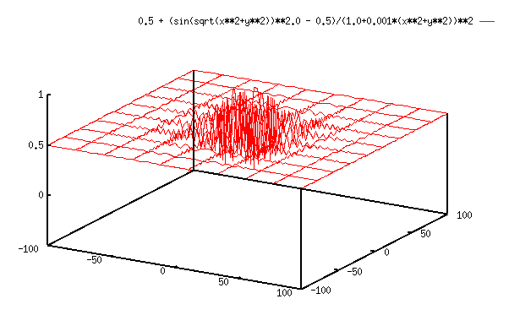
Introduction to Evolutionary Computation:
A Simple Example
A 3D view of f6(x,y):

Slide 13
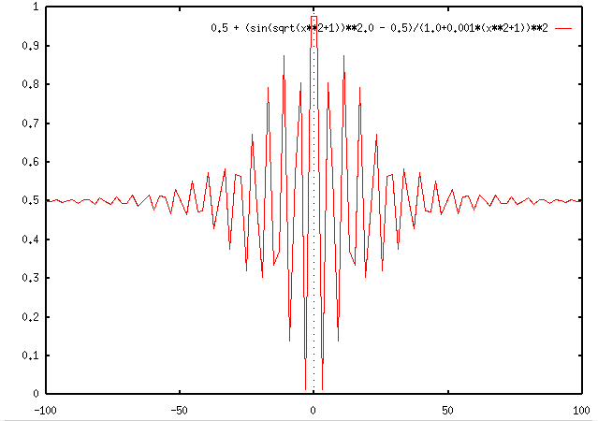
Introduction to Evolutionary Computation:
A Simple Example
If we just look at only one dimension f6(x,1.0)

Slide 14
Introduction to Evolutionary Computation:
A Simple Example
Let’s develop a simple EC for solving this problem
An individual (chromosome or CS)
  <x_{i},y_{i}>
  fit_{i} = f6(x_{i},y_{i})

Slide 15
Introduction to Evolutionary Computation:
A Simple Example
Procedure simpleEC{
t = 0;
Initialize Pop(t); /* of P individuals */
Evaluate Pop(t);
while (t <= 4000-P){
Select_Parent(<x_{mom},y_{mom}>); /* Randomly */
Select_Parent(<x_{dad},y_{dad}>); /* Randomly */
Create_Offspring(<x_{kid},y_{kid}>):
x_{kid} = rnd(x_{mom,} x_{dad}) + N_{x}(0,σ);
y_{kid} = rnd(y_{mom,} y_{dad}) + N_{y}(0,σ);
fit_{kid} = Evaluate(<x_{kid},y_{kid}>);
Pop(t+1) = Replace(worst,kid);{Pop(t)-{worst}}∪{kid}
t = t + 1;
}
}

Slide 16
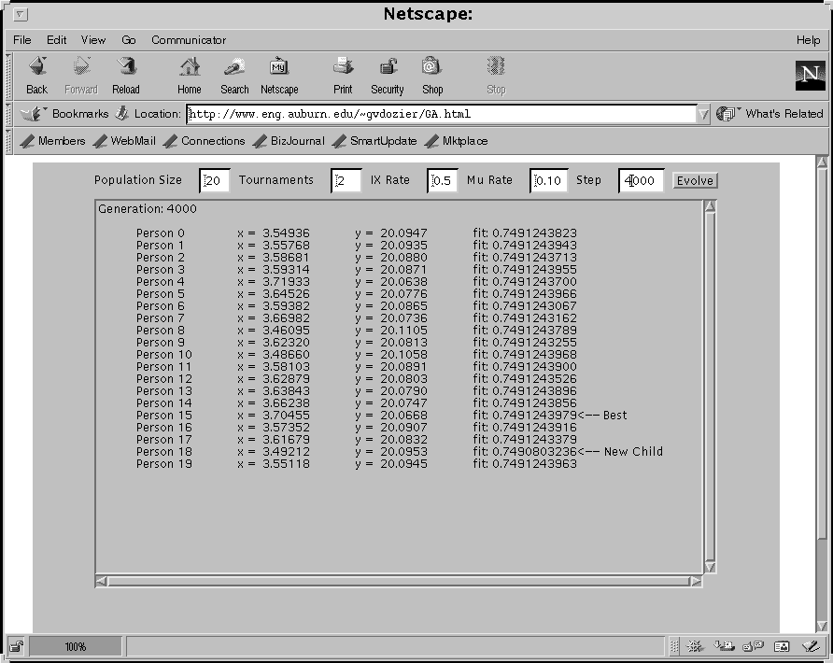
Introduction to Evolutionary Computation:
A Simple Example
To simulate this simple EC we can use the applet at:
http://www.eng.auburn.edu/~gvdozier/GA.html

Slide 17
Introduction to Evolutionary Computation:
A Simple Example
To get a better understanding of some of the properties of ECs let’s do the ‘in class’ lab found at: http://www.eng.auburn.edu/~gvdozier/GA_Lab.html

Slide 18
Introduction to Evolutionary Computation:
Reading List
Bäck, T., Hammel, U., and Schwefel, H.-P. (1997). “Evolutionary Computation: Comments on the History and Current State,” IEEE Transactions on Evolutionary Computation, VOL. 1, NO. 1, April 1997.
Spears, W. M., De Jong, K. A., Bäck, T., Fogel, D. B., and de Garis, H. (1993). “An Overview of Evolutionary Computation,” The Proceedings of the European Conference on Machine Learning, v667, pp. 442-459. (http://www.cs.uwyo.edu/~wspears/papers/ecml93.pdf)
De Jong, Kenneth A., and William M. Spears (1993). “On the State of Evolutionary Computation”, The Proceedings of the Int'l Conference on Genetic Algorithms, pp. 618-623. (http://www.cs.uwyo.edu/~wspears/papers/icga93.pdf)

Slide 19
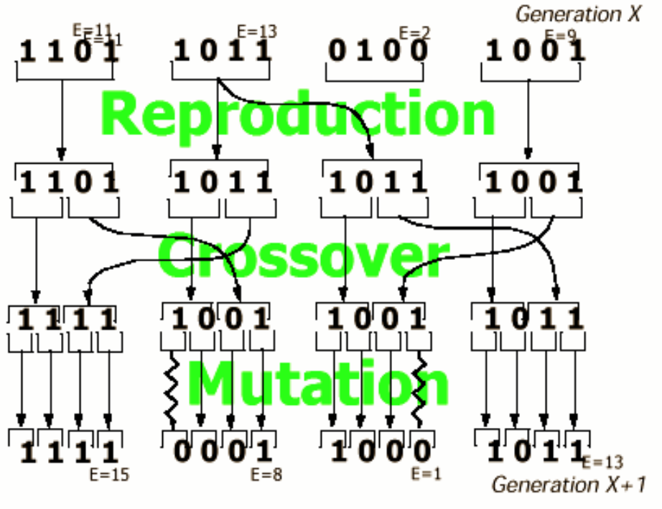
Genetic Algorithm
In the basic GA, objects are coded up (carefully) as binary
strings. Goal is to optimize some function of the bit-strings.
Crossover and Mutation

Slide 20
GA Issues
• Bitstring representation is critical. This is the real ingenuity – not the
decision to use genetic algorithms. (How to encode TSP?)
• Evaluation function design often critical. In-laws always critical.
• It’s often cheaper to evaluate an incremental change of a previously
evaluated object than to evaluate from scratch. Do Genetic
Algorithms permit that?
• What if approximate evaluation is cheaper than accurate evaluation?
• Inner-loop optimization often possible.
Numerous twiddles:
• Use rankings not evaluations in creating your pi parent selection
probabilities.
• Cross over contiguous chunks of the string instead of random bits?
• Needn’t be bit strings .. could use strings over other finite alphabets.
• Optimize over sentences from a grammar representing functions or programs. Called Genetic Programming.

Slide 21
General Discussion
Often, the “second best way” to solve a problem.
• But relatively easy to implement. Can save a great deal
of programming effort.
• But great care is needed in designing representations
and movesets. If someone tells you that SA/Hillclimbing
solved their problem, that person is probably not giving
enough credit to their own problem-formulation-ability.
• DON’T solve a problem with these methods that could
be solved by Linear Programming, A-Star search or
Constraint Propagation!
• What if evaluating the objective function is really

